Slide 1
Zero-Shot Video Generation
Team Members:
Amey Mahendra Thakur,
Jithin Gijo Varghese,
Ritika Agarwal
Instructor: Dr. Yasser Alginahi
Date: November 22, 2023
University of Windsor

Slide 2
AGENDA | Introduction
 | Problem Statement
 | Dataset Overview
 | Model Description
 | References

Slide 3
INTRODUCTION
Notes:
Think about describing a story or an idea in words, and a computer turning those words into a video without being explicitly taught how. That's what we're working on—teaching computers to understand descriptions and create videos all on their own. It's like teaching them a new language that helps them make videos from scratch. This could be a big deal for things like making movies, educational videos, or even just expressing ideas in a fun way. We're using really smart computer programs that learn from examples to do this. Our goal is to make these videos look good and match what people say, without having to teach the computer by showing it lots of videos beforehand. Come see how we're pushing the boundaries of technology to make computers more creative!"

Slide 4
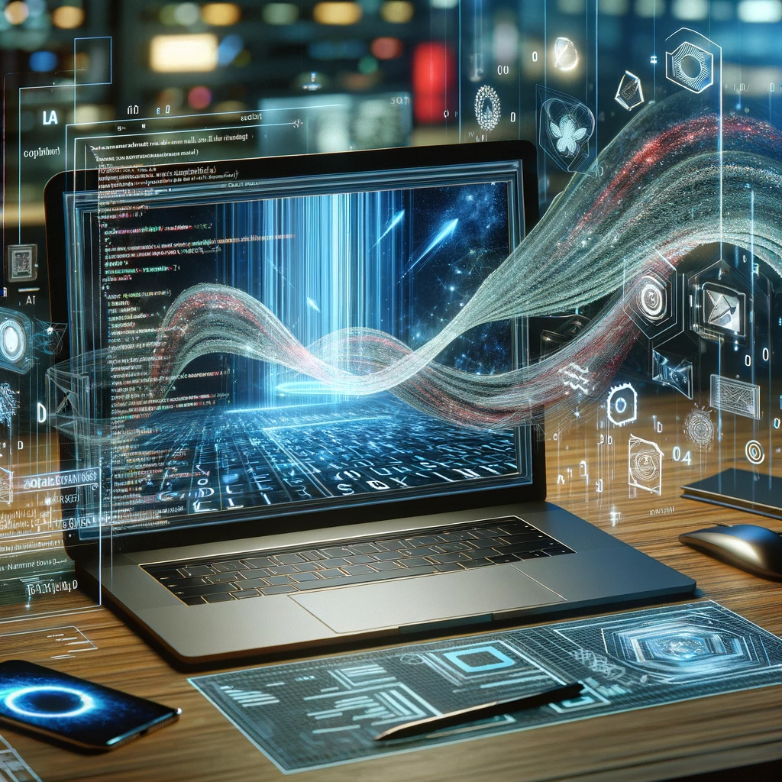
Bridging Text and Video with AI
Innovative AI Research: "Text-to-Image Diffusion Models" research by Picsart AI Research Lab.
Textual to Visual Transformation: Converting text descriptions into dynamic videos.
Interdisciplinary Fusion: Merging natural language processing and computer vision.
Meeting Modern Demand: Addressing the growing need for dynamic visual content.
Visual Language Interpretation: Enabling machines to render human language visually.
Notes:
A key concept of our approach is to modify a pre-trained text-to-image model (e.g., Stable Diffusion), enriching it with temporally consistent generation. By building upon already trained text-to-image models, our method takes advantage of their excellent image generation quality and enhances their applicability to the video domain without performing additional training.

Slide 5
PROBLEM STATEMENT

Slide 6
Revolutionizing Visual Storytelling
Innovative Concept: Create and edit videos easily using just text, no need for expensive tools.
Approach:
Utilizes a pre-trained model adept at converting text into images.
No complex learning or fine-tuning required for the model.
Enhancing Video Dynamics:
Adds motion for natural, smooth video flow.
Ensures consistency across frames with 'cross-frame attention'.
Broad Applications: Not limited to video creation; extends to customized video generation and editing via text instructions.
User-Friendly Technology: Simplifies video production, turning text descriptions into vivid videos.
Notes:
Text-to-video synthesis is a relatively new research direction.
Existing approaches try to leverage autoregressive transformers and diffusion processes for the generation.
CogVideo extends the text-to-image model CogView 2 by tuning it using a multi-frame-rate hierarchical training strategy to better align text and video clips.
Video Diffusion Models (VDM) naturally extend text-to-image diffusion models and train jointly on image and video data. Imagen Video constructs a cascade of video diffusion models and utilizes spatial and temporal super-resolution models to generate high-resolution time-consistent videos.
Make-A-Video Builds upon a text-to-image synthesis model and leverages video data in an unsupervised manner. Gen-1 extends SD and proposes a structure and content-guided video editing method based on visual or textual descriptions of desired outputs. Tune-A-Video proposes a new task of one-shot video generation by extending and tuning SD on a single reference video.

Slide 7
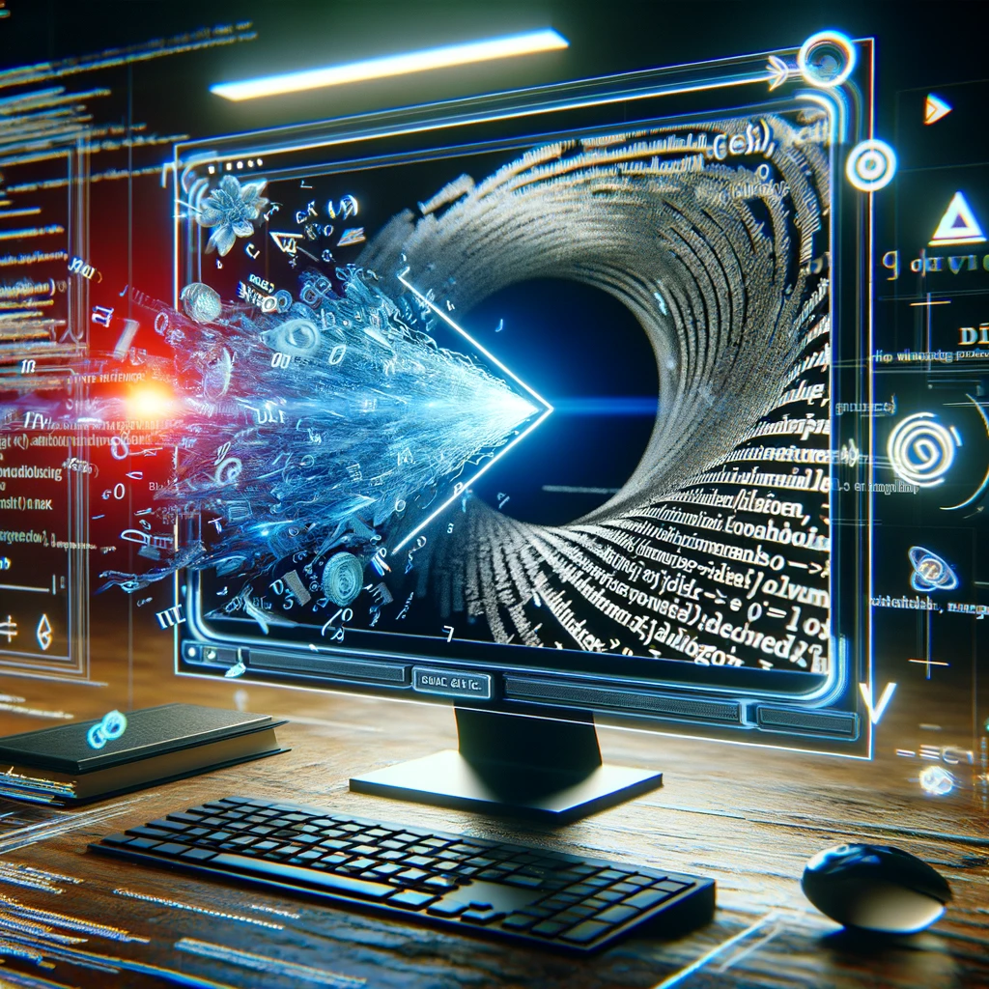
The Impact of Text2Video-Zero
Blending Words and Vision: Transforming textual cues into coherent visual stories.
Revolutionizing Content Creation: Streamlining the process with customized visual outputs.
Enhancing Visual Learning: Rendering abstract educational concepts tangible.
Focusing on Accessibility: Making technology user-friendly for diverse audiences.
Notes:
Unlike the methods mentioned above, our approach is completely training-free, does not require massive comput-ing power or dozens of GPUs, which makes the video generation process affordable for everyone. In this respect, Tune- a-Video comes closest to our work, as it reduces the necessary computations to tuning on only one video. How- ever, it still requires an optimization process and is heavily dependent on the reference video.

Slide 8
DATASET OVERVIEW

Slide 9
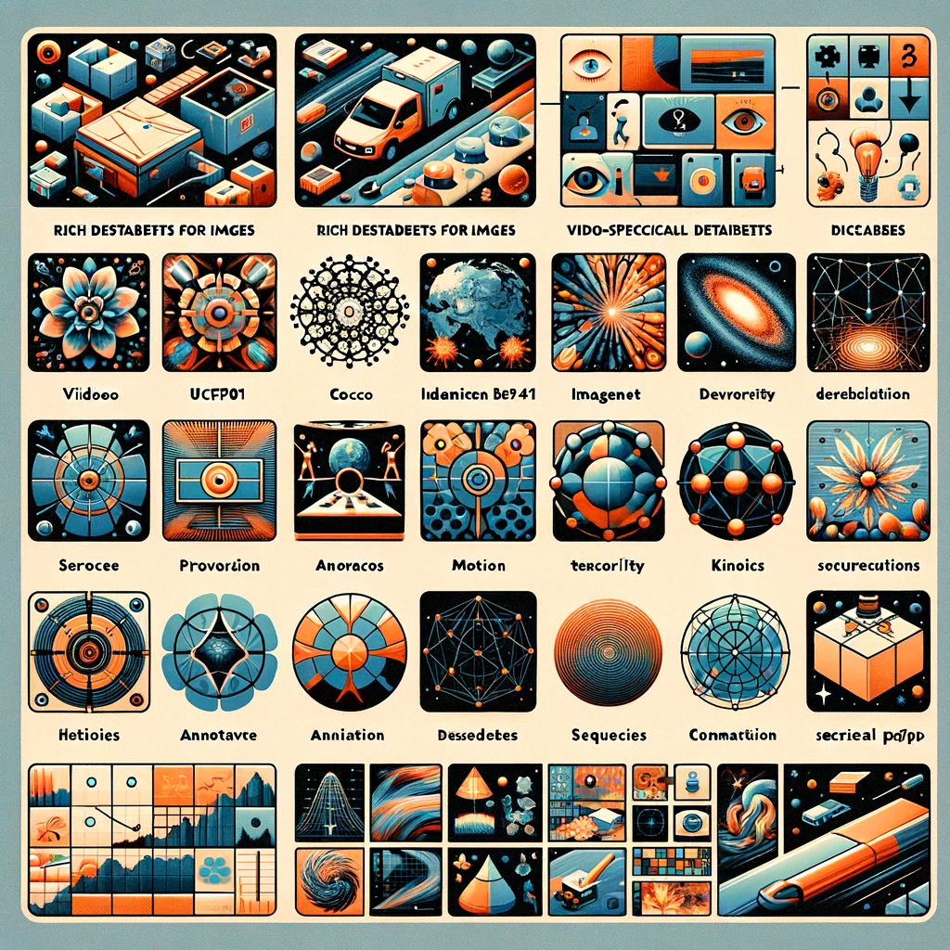
Building Blocks: Datasets in Focus
Rich Datasets for Images: COCO and ImageNet for all kinds of objects and scenes.
Video-Specific Datasets: UCF101 and Kinetics to understand motion and temporal dynamics.
Diversity in Data: Ensuring the model's capability to interpret a wide array of textual prompts.
High-Resolution Priority: Selecting datasets with high-resolution images for superior video quality.
Annotated for Accuracy: Leveraging datasets with textual descriptions for effective supervised learning.
Temporal Elements: Including sequences to capture movement and change, crucial for video synthesis.

Slide 10
MODEL DESCRIPTION

Slide 11
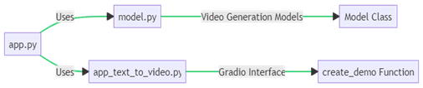
Zero-Shot Video Generation: An Overview
Web-Based AI Application: Facilitating text-to-video creation via a web interface.
Text-to-Image Model Integration: Utilizing diffusion models for video synthesis.
Structured Implementation: Organized through app.py, model.py, app_text_to_video.py.

Slide 12
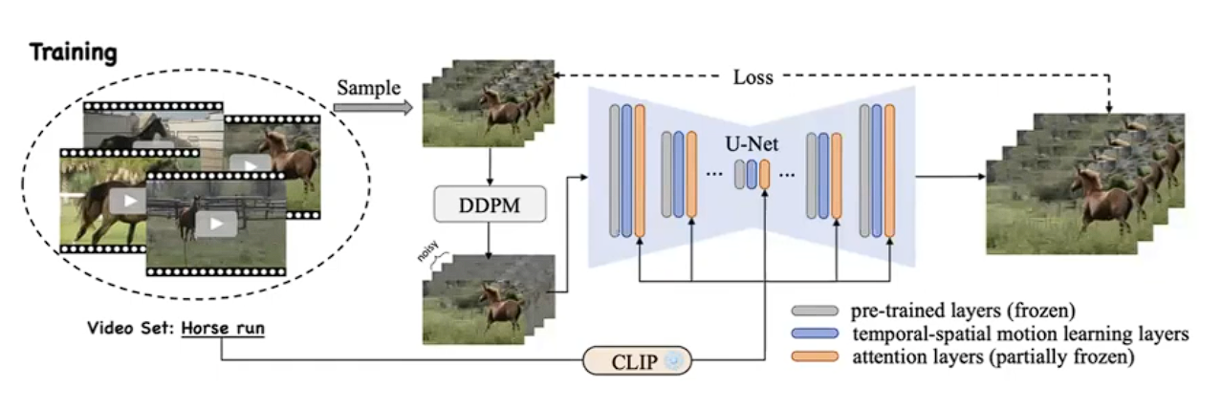
Diving into the Model Training
Limitation of No motion prior & generates similar looking frames
Learns motion dynamics with very little data i.e. 8-16 videos

Slide 13
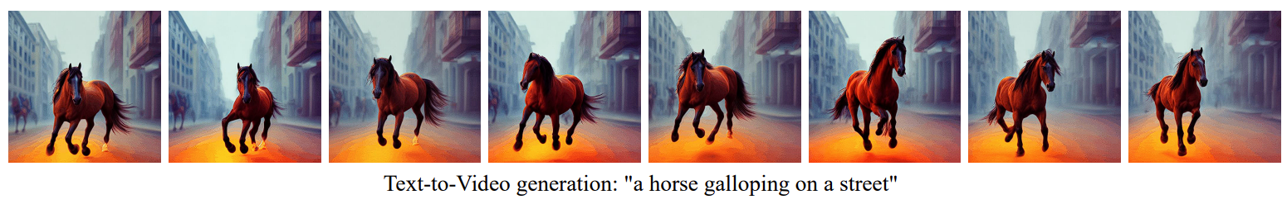
Converting Words into Visual Narratives
Textual Input Processing: How the system interprets and processes text.
Diffusion Model Integration: Utilizing Text-to-Image Diffusion Models for video synthesis.
Visual Output Creation: Transforming text into coherent video sequences.

Slide 14
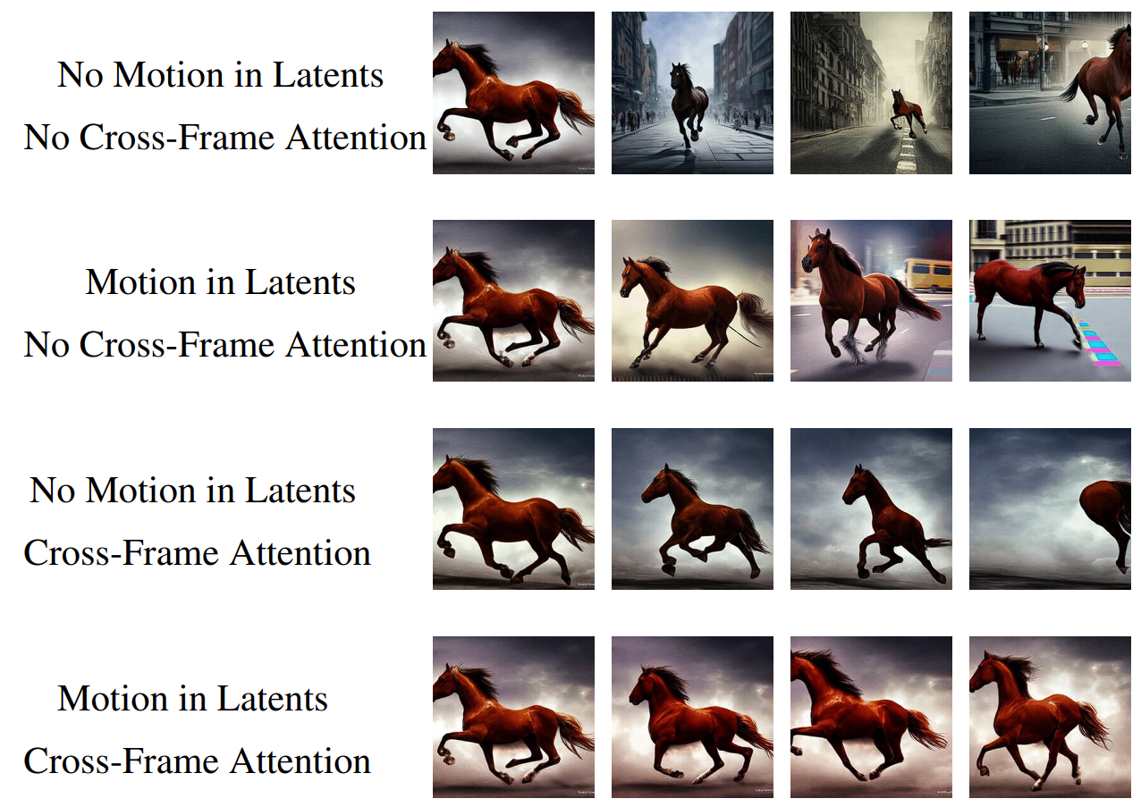
Text to Video Generation: Features
A demonstration on how unique features enhance text-to-video generation and text-guided video editing.

Slide 15
Key ML Libraries Powering Model
PyTorch: For building and training the neural network. Chosen for its flexibility and ease of use in designing custom models.
Gradio: Utilized to create the web interface. It simplifies the process of building interactive interfaces for our model.
OpenCV: Employed for image and video processing tasks. Offers robust tools for handling visual data.
Numpy: Integral for numerical computations. Aids in efficient handling of large datasets and mathematical operations.
Diffusers: Specifically used for implementing and managing diffusion models, which are central to our text-to-video conversion process.
Imageio: For reading and writing a wide range of image and video formats, crucial in the generation of output videos.
Notes:
PyTorch:
Explanation: In our project, PyTorch serves as the core framework for building and training the neural network responsible for converting text descriptions into dynamic videos. PyTorch's flexibility and ease of use make it an ideal choice for designing custom models, allowing us to have fine-grained control over the architecture and training process.
Gradio:
Explanation: Gradio plays a crucial role in enhancing user interaction with our model. We use Gradio to create a web interface, simplifying the process of interacting with Text2Video-Zero. This interactive interface allows users to input text and visualize the dynamically generated videos, making the model more accessible and user-friendly.
OpenCV:
Explanation: OpenCV is employed in our project for essential image and video processing tasks. It provides robust tools for handling visual data, ensuring that the model can effectively process and manipulate images as it converts text descriptions into dynamic video content. OpenCV contributes to the overall efficiency of the visual data processing pipeline.
Numpy:
Explanation: Numpy is integral to our project for efficient numerical computations. It aids in handling large datasets and performing mathematical operations crucial for the machine learning tasks involved in Text2Video-Zero. Numpy's capabilities contribute to the model's ability to process and understand textual prompts efficiently.
Diffusers:
Explanation: In the context of our project, Diffusers are specialized components dedicated to implementing and managing diffusion models. These models are central to the text-to-video conversion process in Text2Video-Zero. Diffusion models simulate how information spreads over time, capturing the dynamic transformation from textual input to video output.
Imageio:
Explanation: Imageio is a key component in our project for reading and writing a variety of image and video formats. It plays a crucial role in handling the input and output of visual data during the text-to-video generation process. Imageio contributes to the generation of high-quality, time-consistent videos based on the model's predictions.

Slide 16
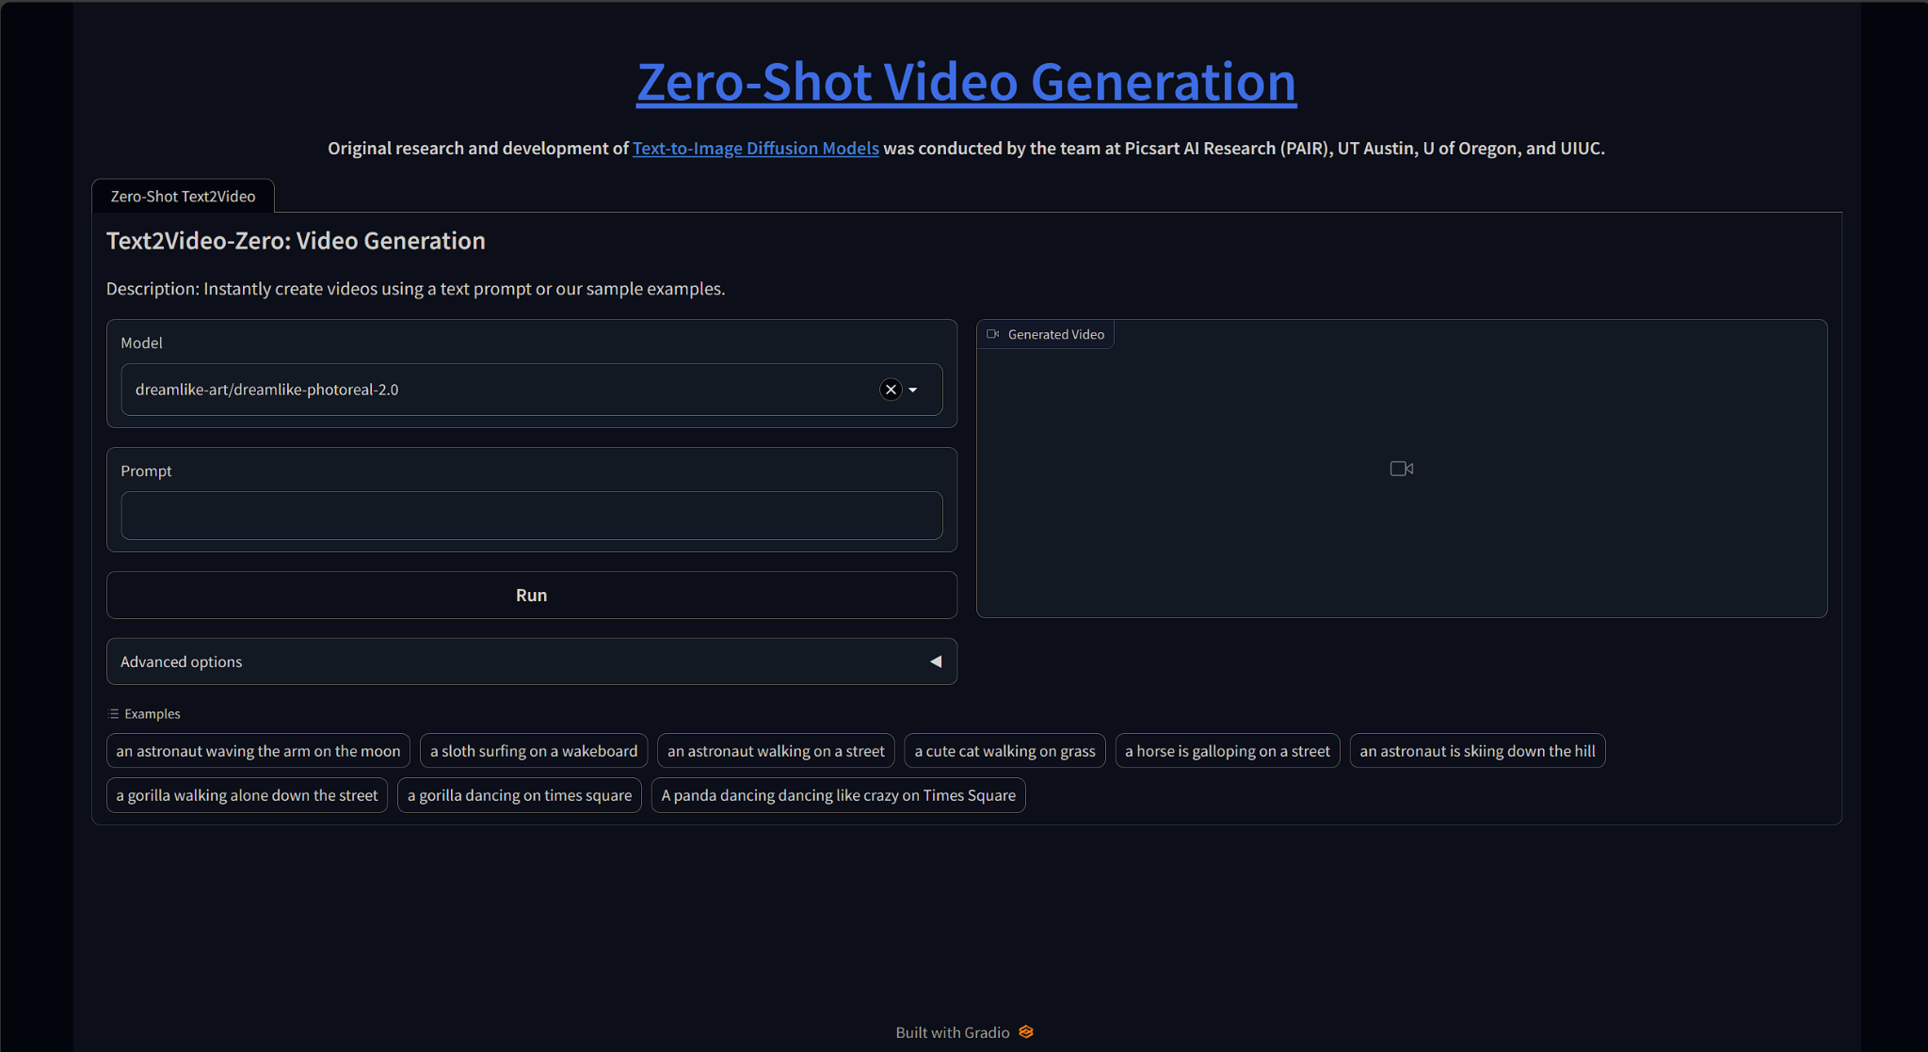
User Interface: Bridging Users and AI

Slide 17
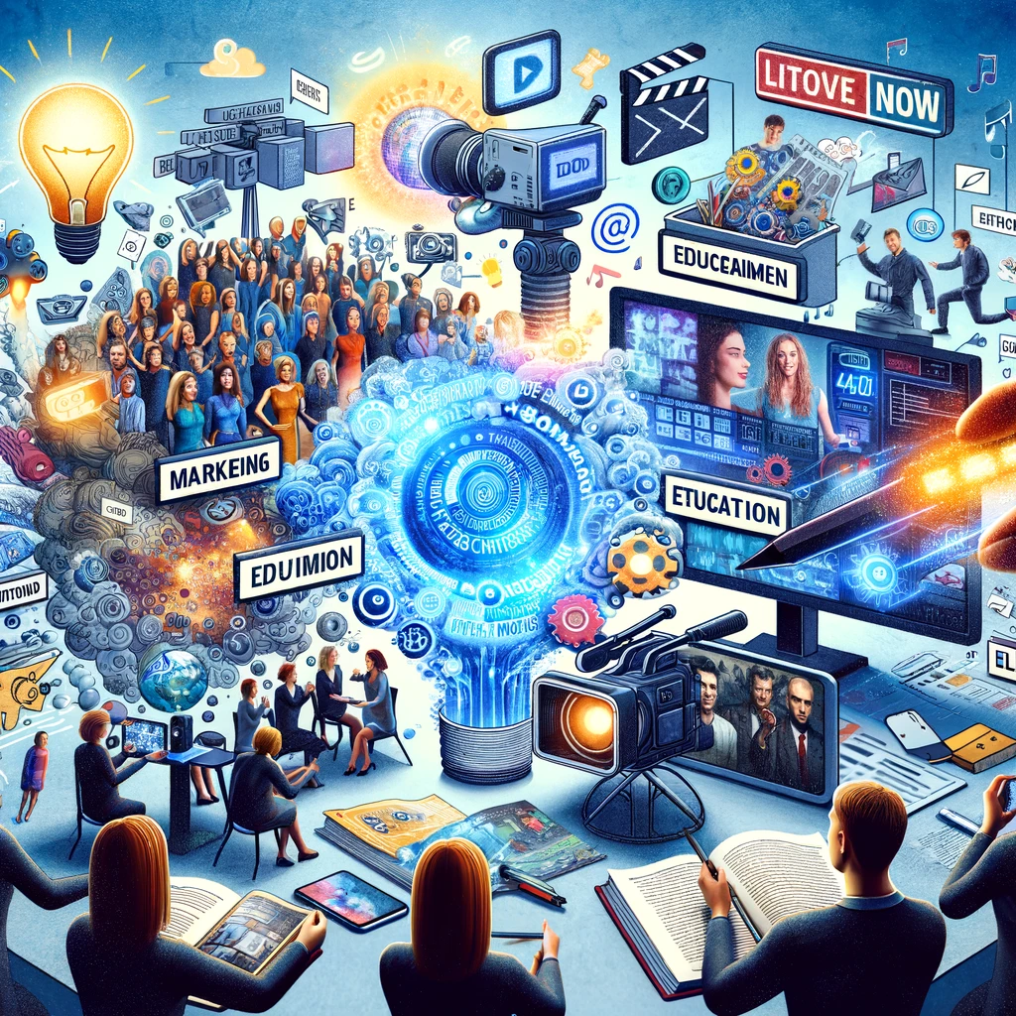
Beyond the Lab: Real-World Applications
Content Creation: Revolutionizing digital storytelling and media production.
Educational Tools: Enhancing learning experiences with visual aids.
Industry Implications: Potential impact across various sectors including marketing, education, and entertainment.

Slide 18
REFERENCES

Slide 19
References
[1] | L. Khachatryan et al., “Text2Video-Zero: Text-to-Image Diffusion Models are Zero-Shot Video Generators,” arXiv.org, Mar. 23, 2023, https://arxiv.org/abs/2303.13439 [Accessed: Nov. 19, 2023].
[2] | C. Wu et al., “N\"UWA: Visual Synthesis Pre-training for Neural visUal World creAtion,” arXiv:2111.12417 [cs], Nov. 2021, https://arxiv.org/abs/2111.12417 [Accessed: Nov. 19, 2023].
[3] | R. Villegas et al., “Phenaki: Variable Length Video Generation From Open Domain Textual Description,” arXiv.org, Oct. 05, 2022, https://arxiv.org/abs/2210.02399 [Accessed: Nov. 19, 2023].
[4] | W. Hong, M. Ding, W. Zheng, X. Liu, and J. Tang, “CogVideo: Large-scale Pretraining for Text-to-Video Generation via Transformers,” May 2022, https://doi.org/10.48550/arxiv.2205.15868 [Accessed: Nov. 19, 2023].
[5] | J. Ho, T. Salimans, A. Gritsenko, W. Chan, M. Norouzi, and D. J. Fleet, “Video Diffusion Models,” arXiv (Cornell University), Apr. 2022, https://doi.org/10.48550/arxiv.2204.03458 [Accessed: Nov. 19, 2023].
[6] | J. Ho et al., “Imagen Video: High Definition Video Generation with Diffusion Models,” Oct. 2022, https://doi.org/10.48550/arxiv.2210.02303 [Accessed: Nov. 19, 2023].

Slide 20
References
[7] | U. Singer et al., “Make-A-Video: Text-to-Video Generation without Text-Video Data,” Sep. 2022, https://doi.org/10.48550/arxiv.2209.14792 [Accessed: Nov. 19, 2023].
[8] | P. Esser, J. Chiu, P. Atighehchian, J. Granskog, and A. Germanidis, “Structure and Content-Guided Video Synthesis with Diffusion Models,” Feb. 2023, https://doi.org/10.48550/arxiv.2302.03011 [Accessed: Nov. 19, 2023].
[9] | J. Z. Wu et al., “Tune-A-Video: One-Shot Tuning of Image Diffusion Models for Text-to-Video Generation,” arXiv (Cornell University), Dec. 2022, https://doi.org/10.48550/arxiv.2212.11565 [Accessed: Nov. 19, 2023].
[10] | V. Subramanian, Deep Learning with PyTorch. Packt Publishing Ltd, 2018, https://t.ly/Izg92 [Accessed: Nov. 19, 2023].
[11] | Vivian Genaro Motti, D. Raggett, Sascha Van Cauwelaert, and J. Vanderdonckt, “Simplifying the development of cross-platform web user interfaces by collaborative model-based design,” Sep. 2013, https://doi.org/10.1145/2507065.2507067 [Accessed: Nov. 19, 2023].

Slide 21
Thank You

